Slide 1
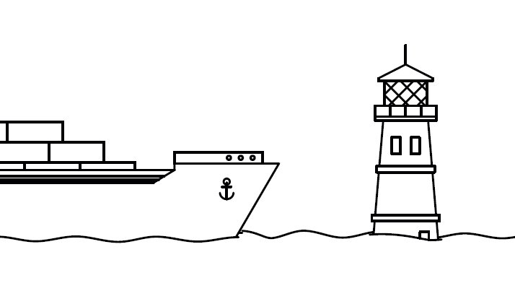
Changing Water Patterns - Preservation
How does sea level rise affect maritime exchange through recently freed up waterways, while also threatening historic space and communities next to water bodies?
LDE Port City Futures, CC-BY-SA 4.0

Slide 2
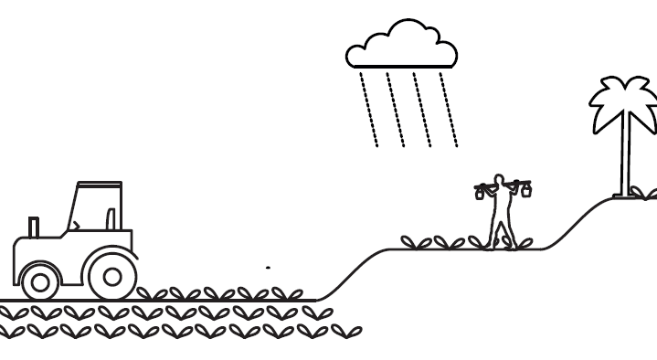
Intensive farming - Small-scale agriculture
How can traditional agricultural water practices inspire the layout, use, and management of irrigation systems in modern industrial farming to make them more sustainable?
LDE Port City Futures, CC-BY-SA 4.0

Slide 3
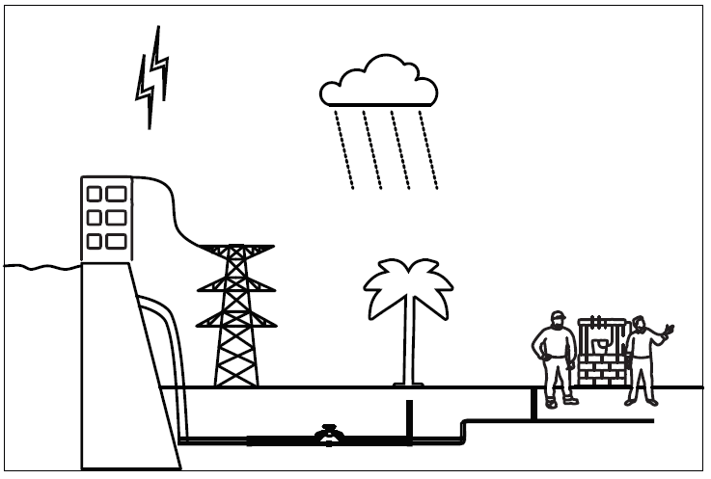
Urban Growth - Water Resilience
How can modern infrastructure (dams) be used to reduce the danger of uneven water distribution for irrigation, drainage, and energy, while facilitating circular practices and enhancing the cleanliness, safety, and sustainability of water resources?
LDE Port City Futures, CC-BY-SA 4.0

Slide 4
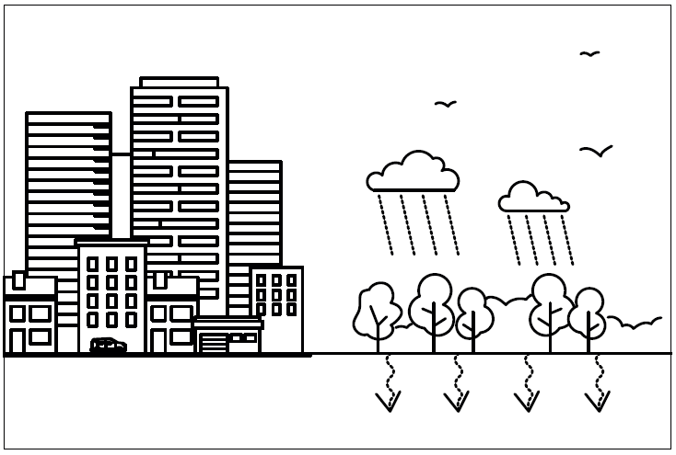
Urban Expansion–Water Awareness 2.0
How does new construction affect sustainable water systems? How can we use education to effectively manage water systems in the built environment?
LDE Port City Futures, CC-BY-SA 4.0

Slide 5
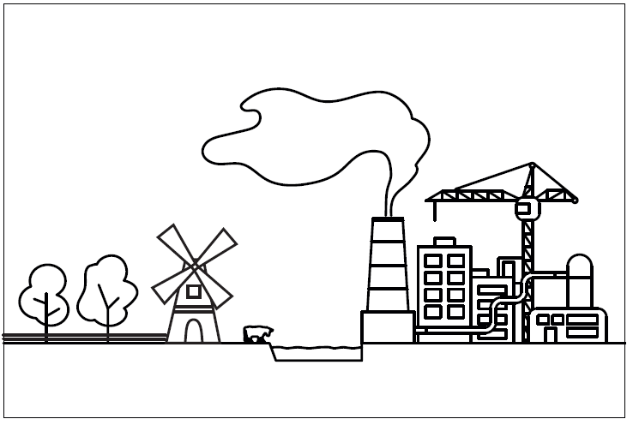
Historic Preservation – Economic Development
How to preserve the values of the historic urban landscape, and the intangible lifestyle related to it, while rehabilitating, renovating, or reconstructing the city's historic urban legacies for economic benefits and city development?
LDE Port City Futures, CC-BY-SA 4.0

Slide 6
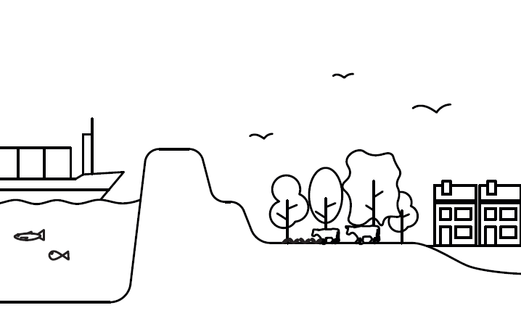
Reclamation vs. Biodiversity
How to reduce the damage to nearshore ecosystems and fishery resources and enhance the self-healing capacity of the hydrodynamic environment, while implementing enclosure of the sea to create land for accommodating the increasingly growing population?
LDE Port City Futures, CC-BY-SA 4.0

Slide 7
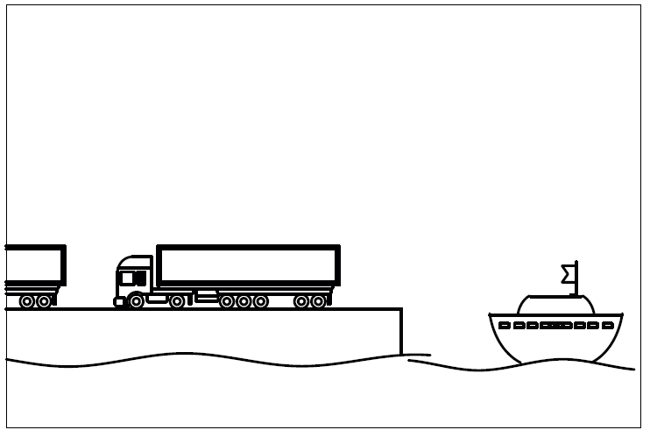
Mobility – Inland waterway
How to integrate shipping into inland networks for more efficient logistics operations?
LDE Port City Futures, CC-BY-SA 4.0

Slide 8
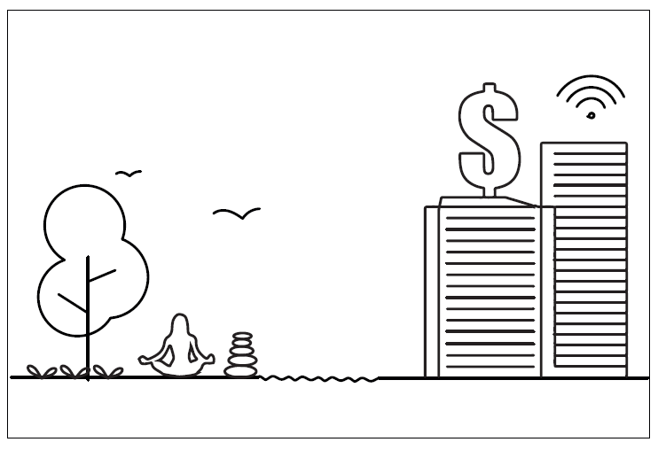
Spiritual Values - Consumption
How can local stakeholders include spiritual values of water in defining its identity as a public good rather than only a product for consumption?
LDE Port City Futures

Slide 9
Notes:
intro slide

